Slide 1

Design an Grading Website for a School
Balakrishna

Slide 2
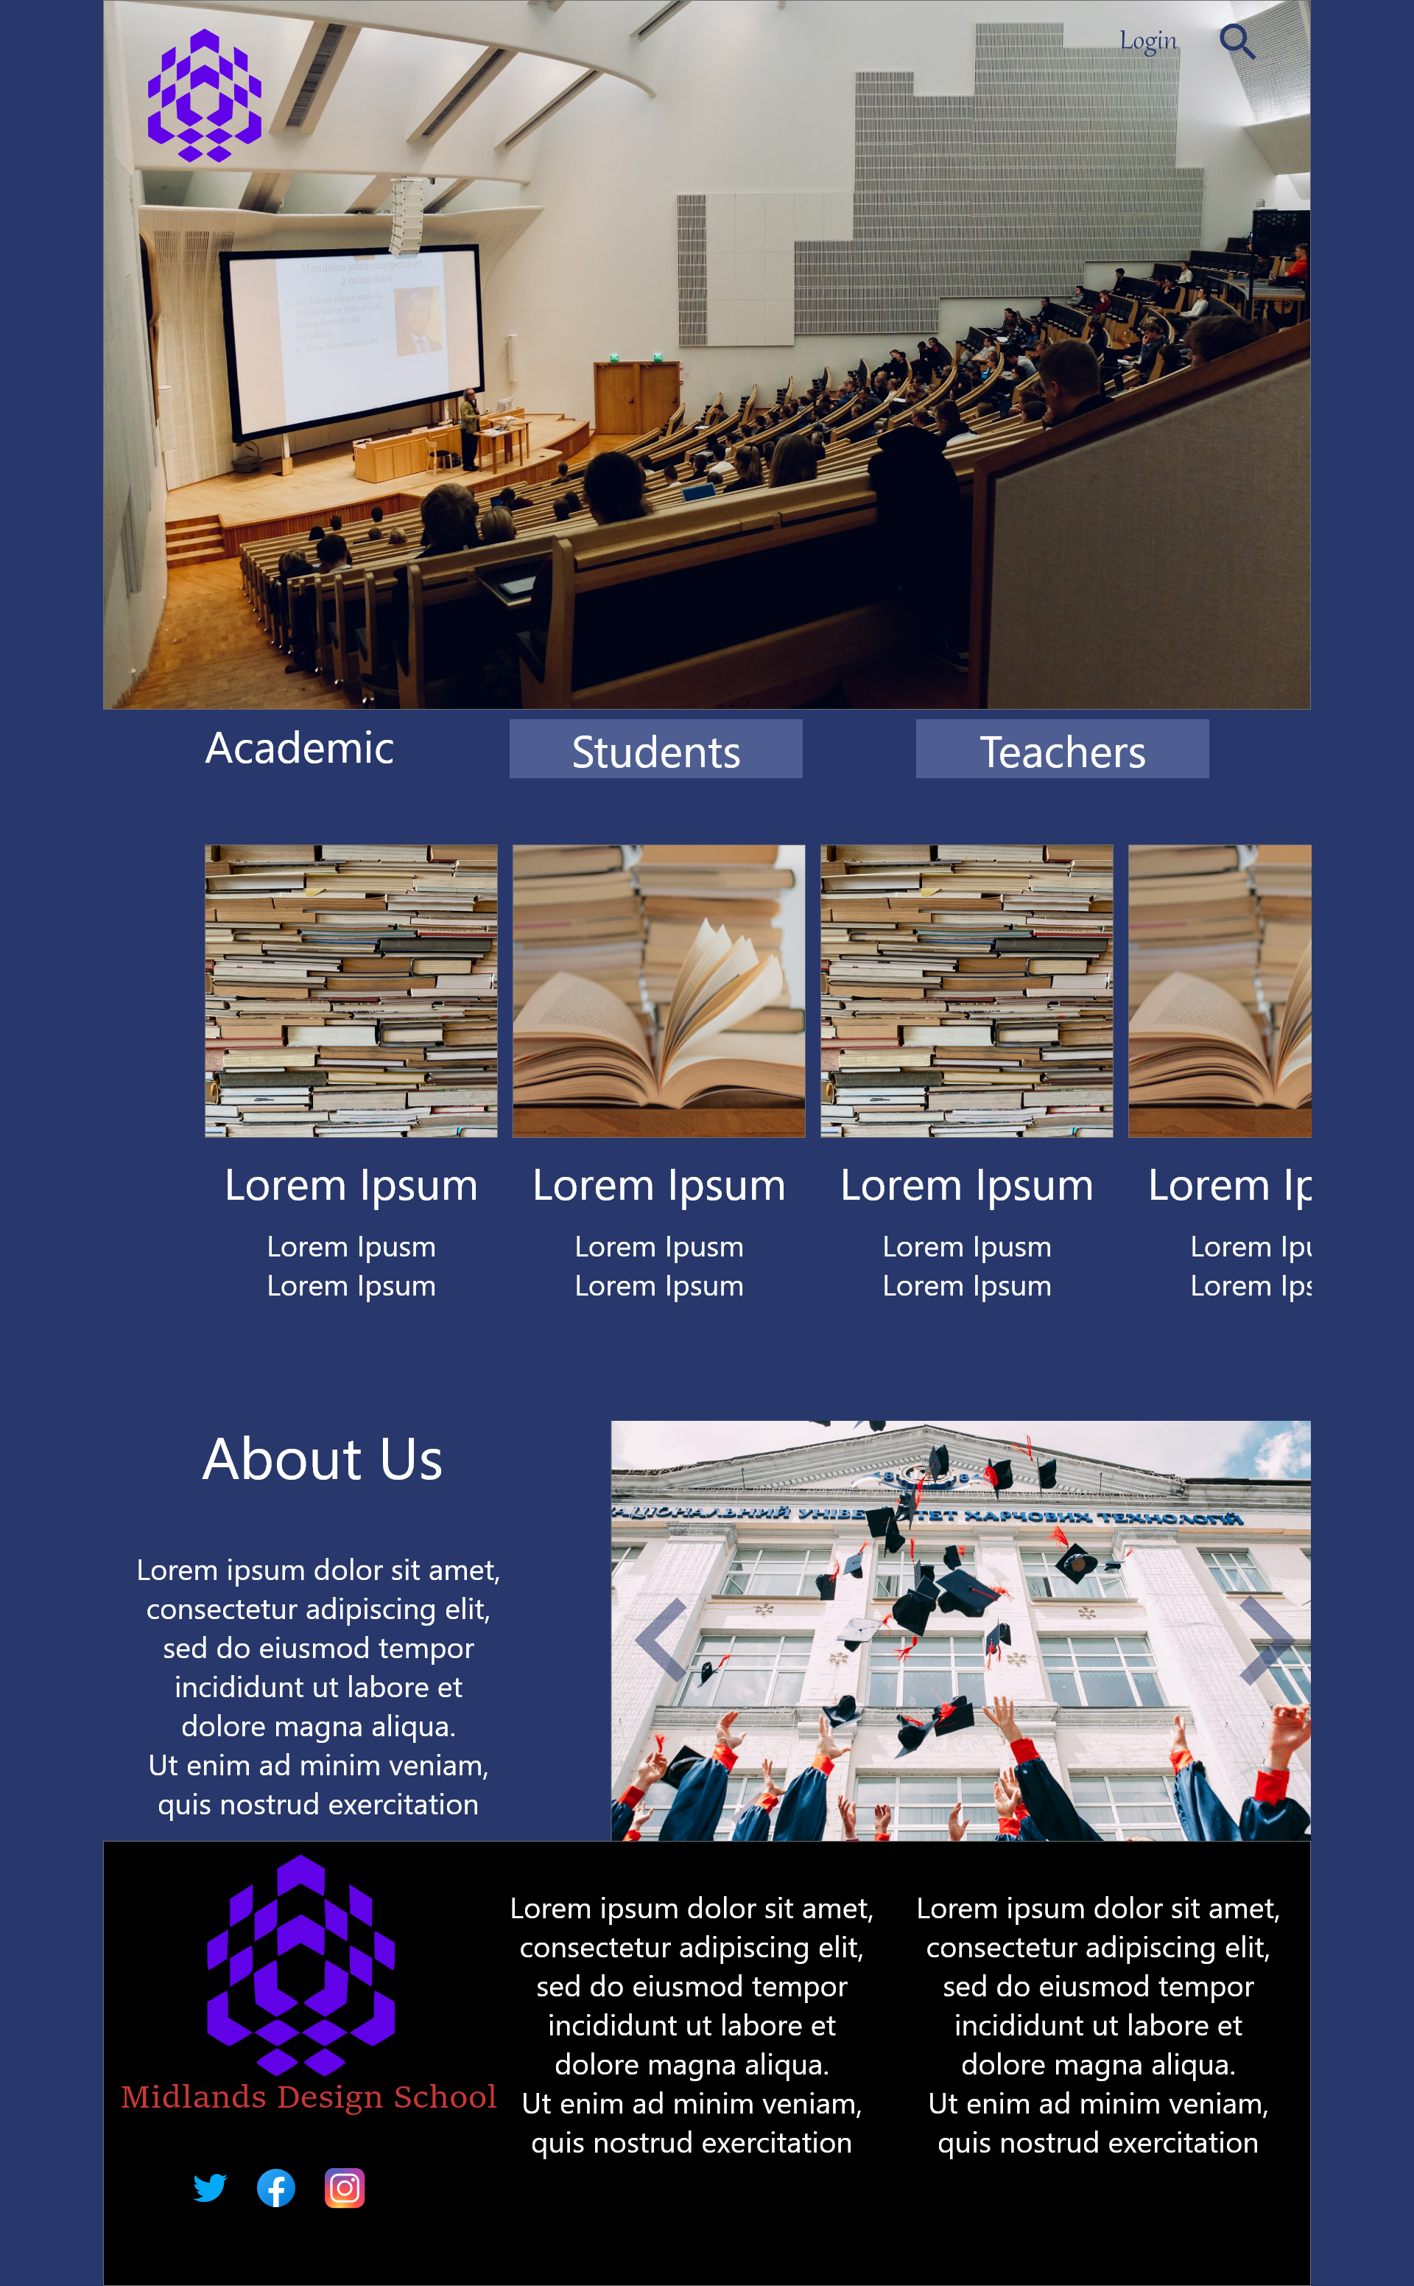

Project overview
The product:
School Grading Website provides a robust web-based workflow for assignment submission and evaluation.
Project duration:
Jan 2022-March 2022

Slide 3
Project overview
The problem:
The solutions in the market for Assignment Grading don't present an integrated assignment management solution specifically when the ask involves a responsive website
The goal:
Design an Assignment Grading Flow for an Online School

Slide 4
Project overview
My role:
User Experience Designer handling the end to end workflow for the project in the Design Phase.
Responsibilities:
User Research and Ideation
Competitive Audit
Wireframing
Low and High Fidelity Design Prototyping
Design Iterations

Slide 5
User research
Personas
Problem statements
User journey maps
Understanding
the user

Slide 6
User research: summary
Based on the user research conducted, we have come up with a design prototype to handle assignment grading and submission.
We have done a Competitive Audit to understand the strengths and weaknesses of the players in the market and found that the solutions existing in the market don't present an integrated assignment management solution specifically when the ask involves a responsive website, but with certain restrictions. The initial rounds of user research asked for more features to be included and the later rounds asked for simplification of design.

Slide 7
User research: pain points
1
2
3
Lack of Solutions
Accessibility
Quick Submissions
Availability of an integrated assignment grading system
No solution available for catering to cross-national academic institutes
The existing solutions don’t allow on the fly update of the results

Slide 8
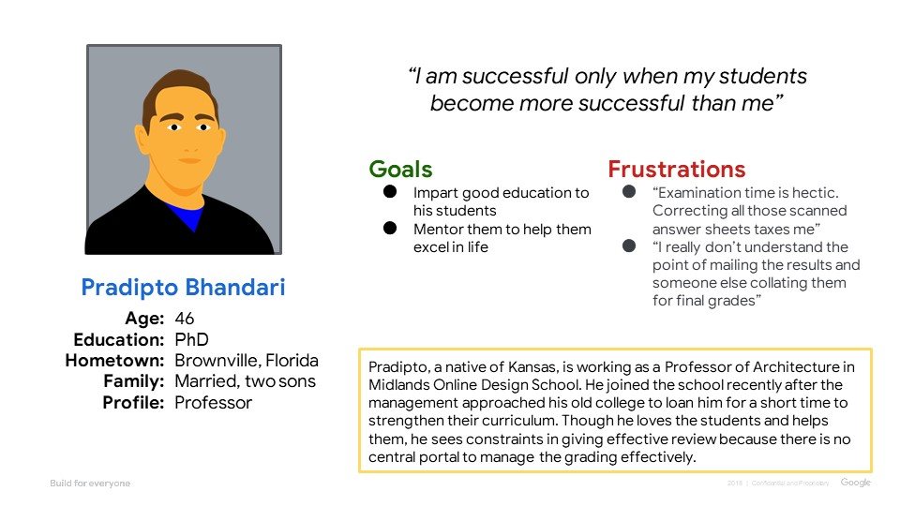
Persona: Pradipto Bhandari
Problem statement:
Pradipto is an Evaluator who needs an online portal to do the exam evaluation because manual correction is tedious and error prone

Slide 9
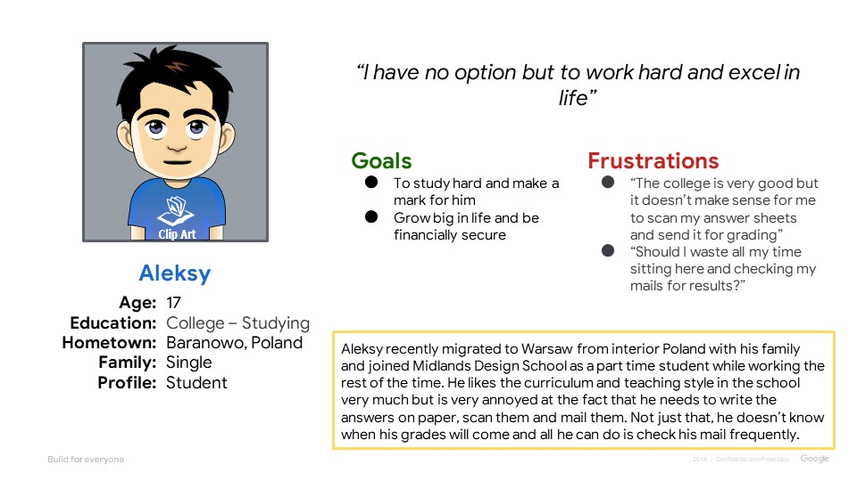
Persona: Aleksy
Problem statement:
Aleksy is a Student who needs a solution to take examinations online because it is too tedious to write them on paper, scan and send them.

Slide 10
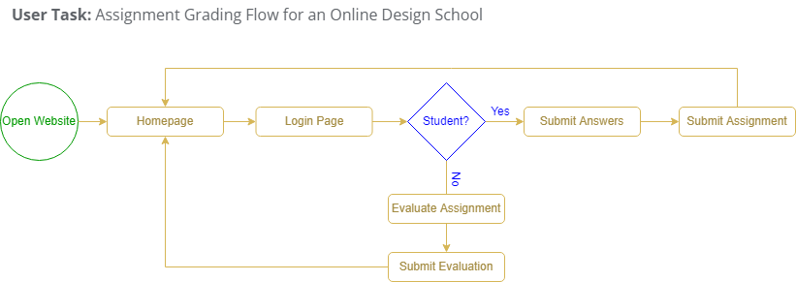
User journey map
The user journey here depicts how a student will submit his assignment and how an evaluator will assess the submissions
Image of user journey map

Slide 11
Paper wireframes
Digital wireframes
Low-fidelity prototype
Usability studies
Starting
the design

Slide 12
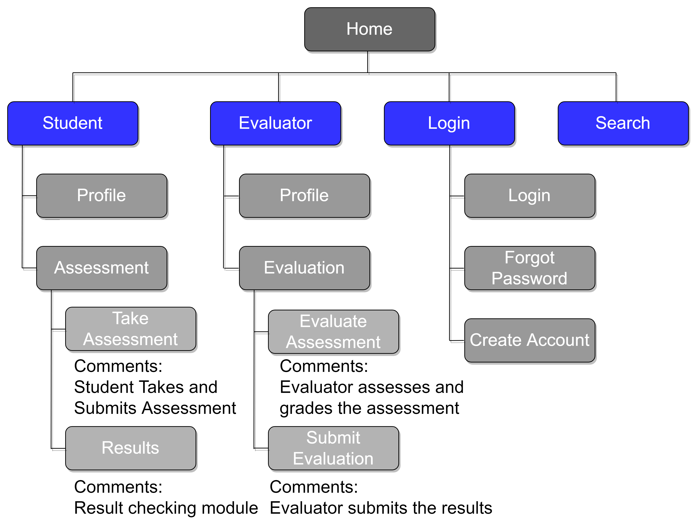
Sitemap
The Sitemap used is hierarchical and has a modular flow based on the functionality under consideration.

Slide 13
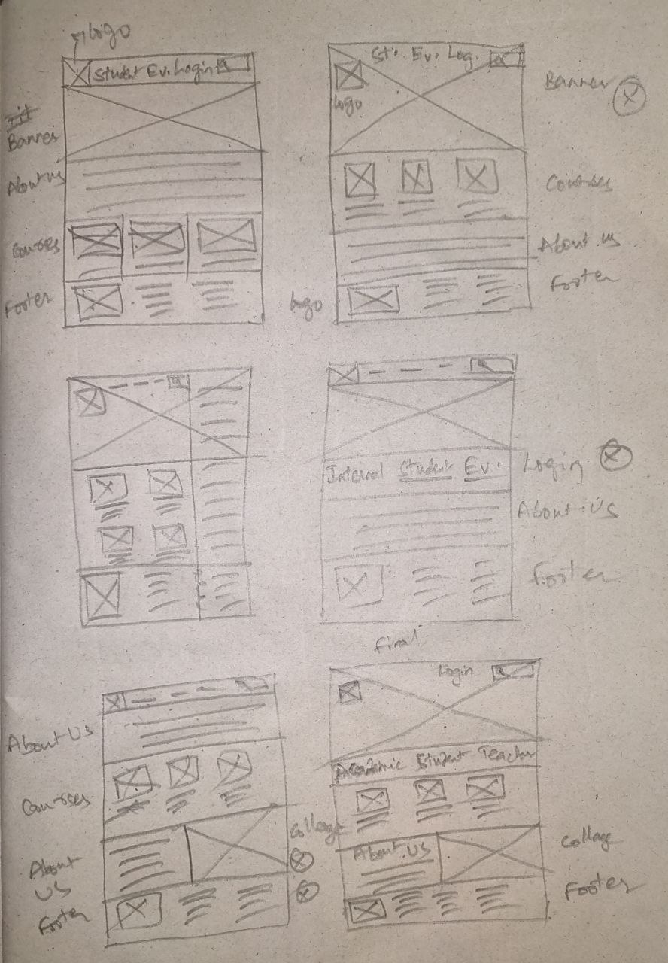
Paper wireframes
Due Diligence was done in designing the wireframes and the most appealing components out of them are considered into the final wireframe along with some changes which are not visible in the original five.
Image of paper wireframes including five different versions of the same screen and one image of the new, refined version

Slide 14
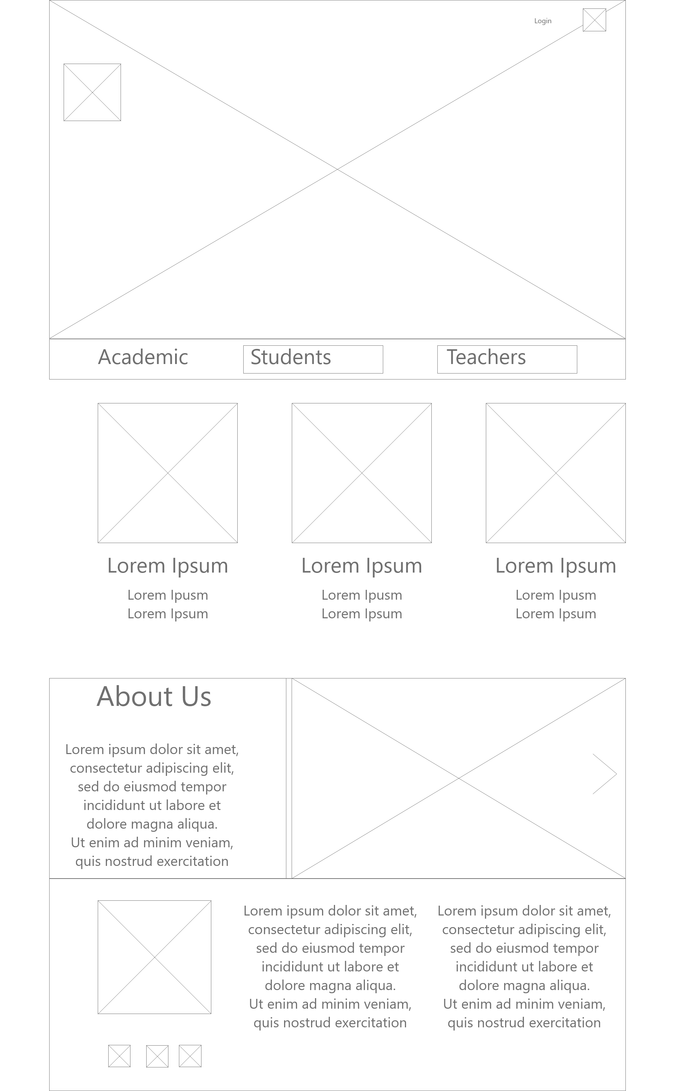
Digital wireframes
The digital wireframe follows the pattern of the paper wireframe created but with some minor changes included to enhance user experience
Insert first wireframe example that demonstrates design thinking aligned with user research

Slide 15
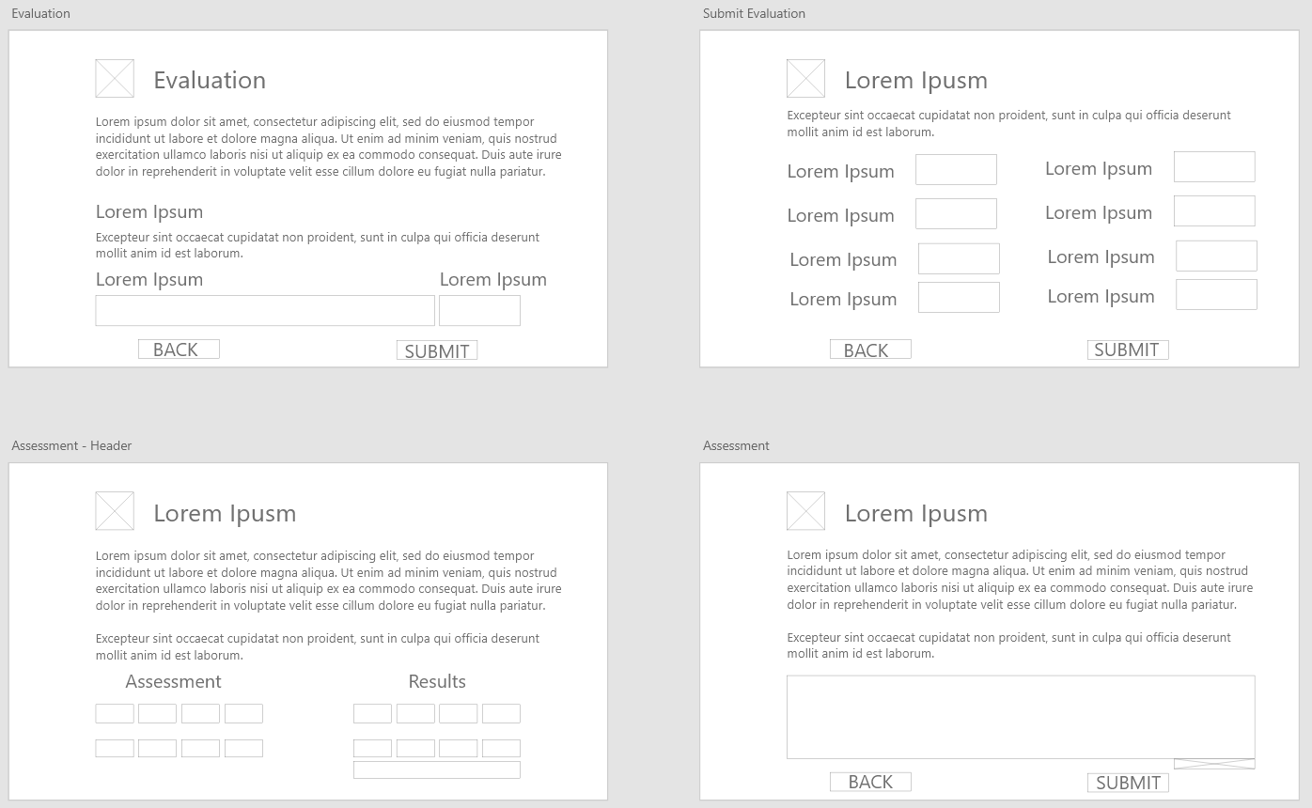
Digital wireframes
This is a follow-up of the first wireframe. The below two flows will be activated based on the user who logs in to the website.
Insert second wireframe example that demonstrates design thinking aligned with user research

Slide 16
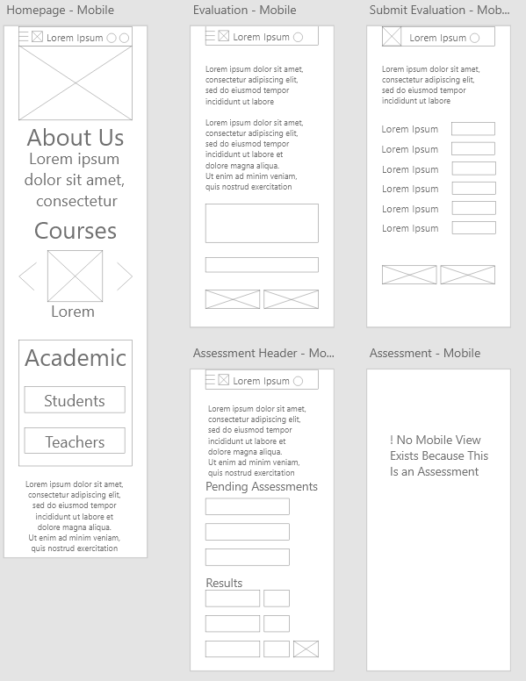
Digital wireframes
A view of the responsive mobile view of the grading website.
This view is designed keeping in view the user comfort in performing the same activities on a mobile phone.

Slide 17
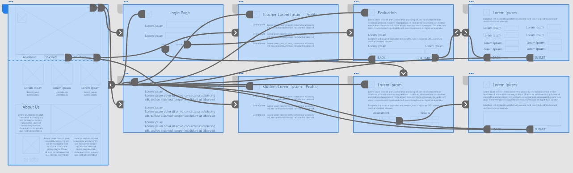
Low-fidelity prototype
The prototype, modelled on the finalized wireframe covers all possible interactions in the app and gives the user a wholesome experience

Slide 18
Usability study: parameters
Study type:
Unmoderated usability study
Location:
United States, remote
Participants:
5 participants
Length:
20-30 minutes

Slide 19
Usability study: findings
Insert a one to two sentence introduction to the findings shared below.
1
2
3
Finding
Finding
Finding
Mobile view for Assignment Submission not needed.
Need to have separate logins for Student and Evaluator.
The Logo should link back to the homepage.

Slide 20
Refining
the design
Mockups
High-fidelity prototype
Accessibility

Slide 21
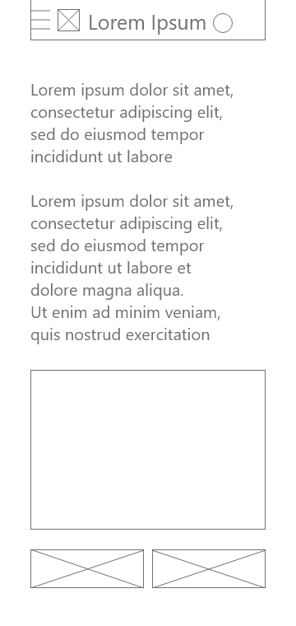
Mockups
Before usability study
After usability study
Early Designs included a responsive mobile view for Assignment Submission. The same is removed in later iterations.
Image of selected screen before usability study
Image of selected screen after usability study

Slide 22
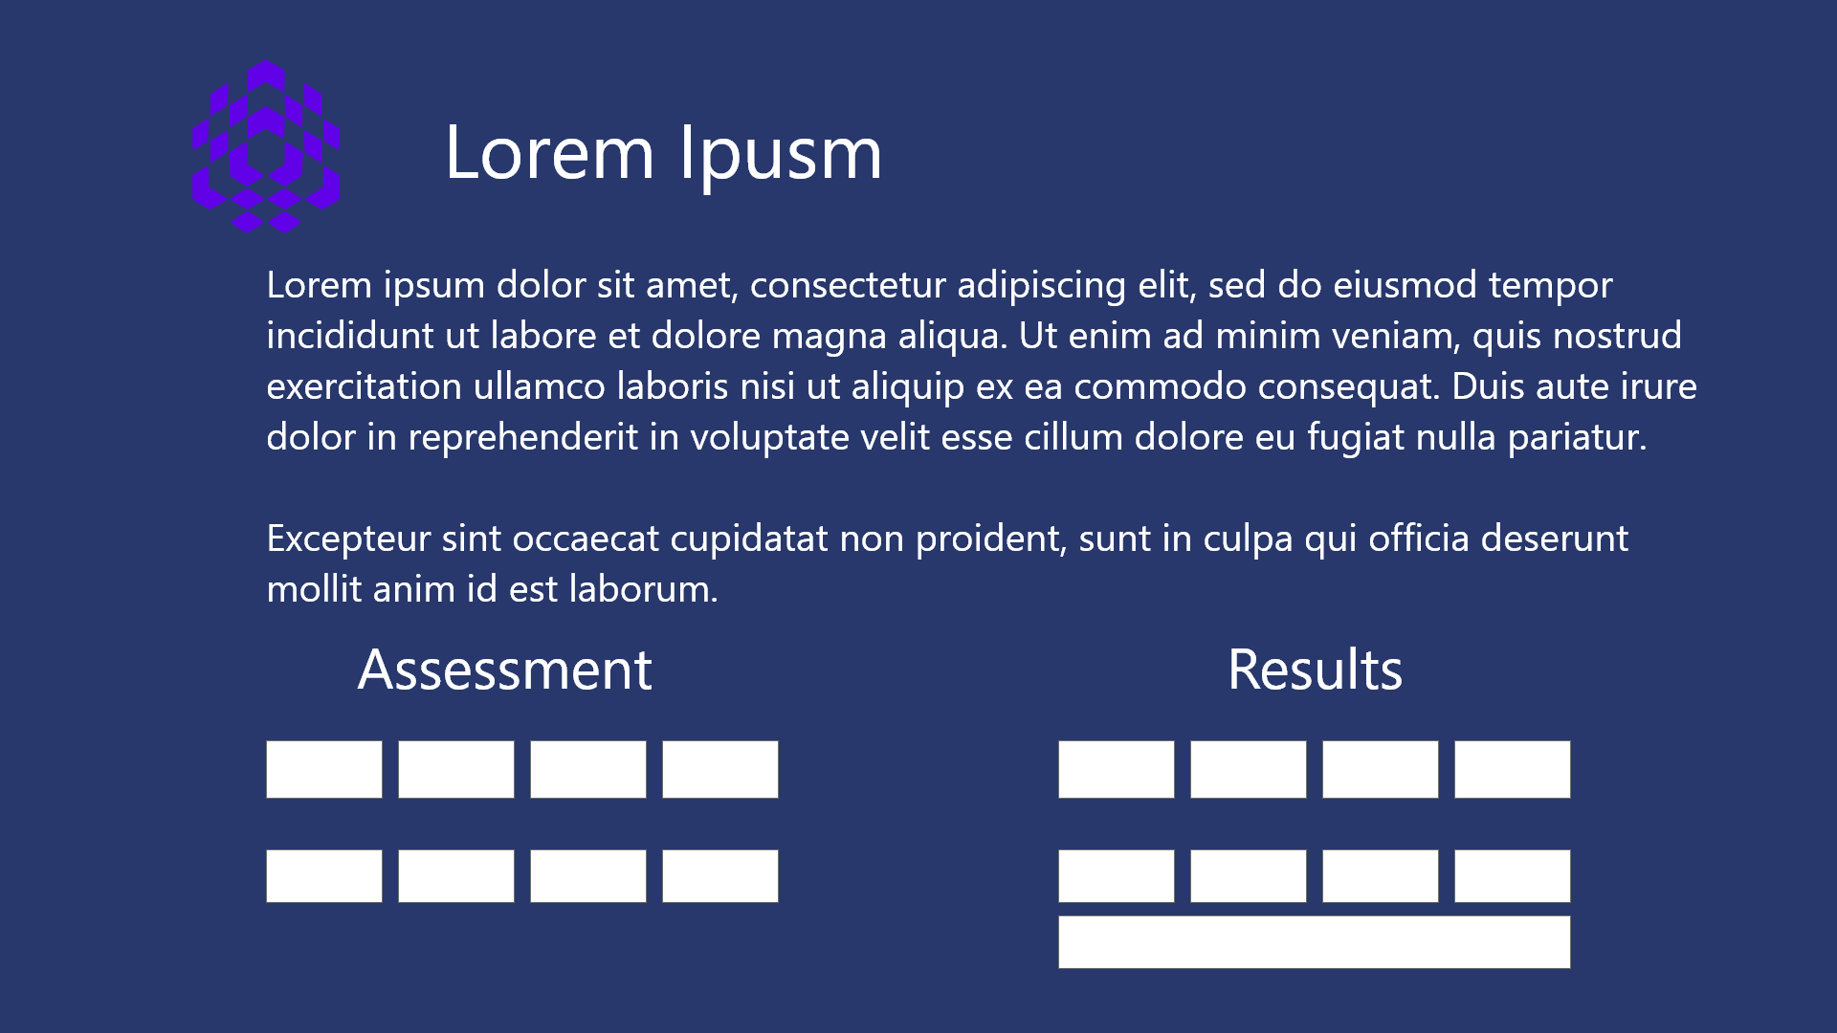
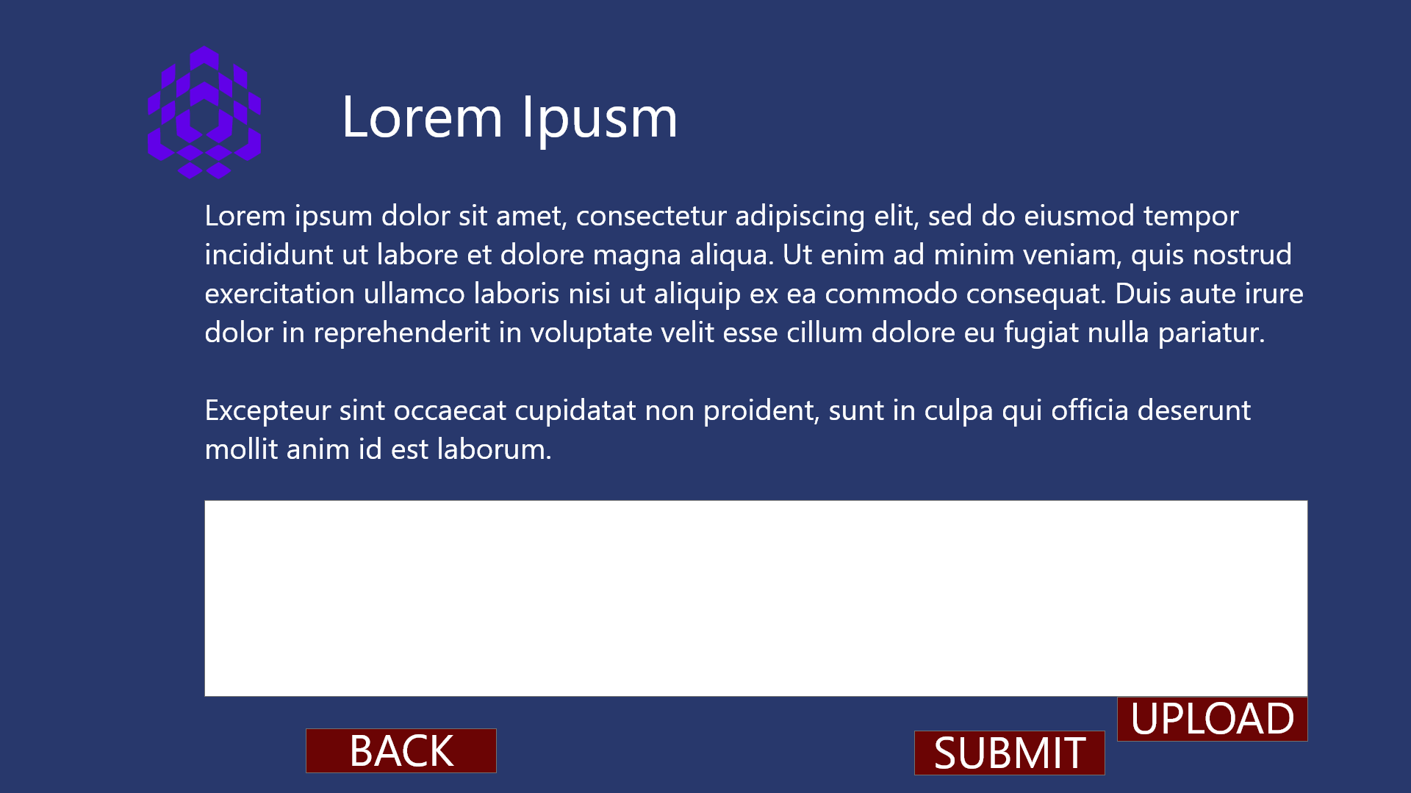
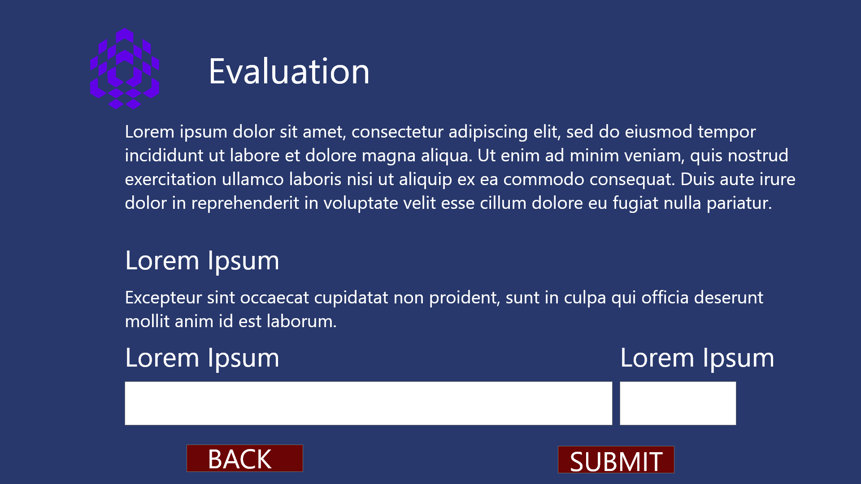
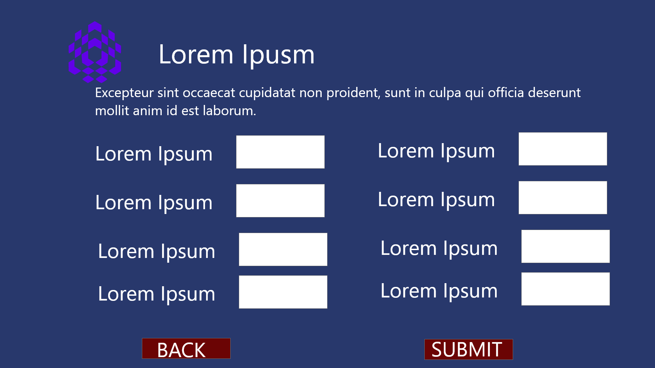
Mockups – Desktop View

Slide 23
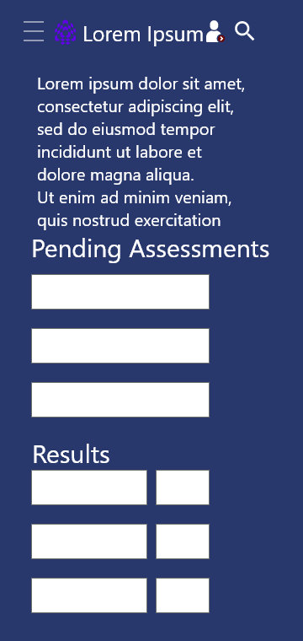
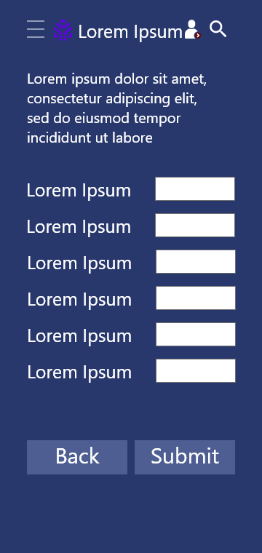
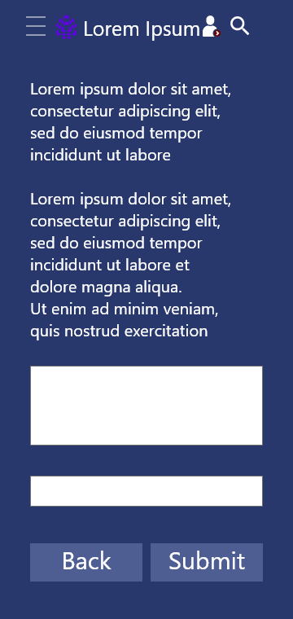
Mockups – Mobile View

Slide 24
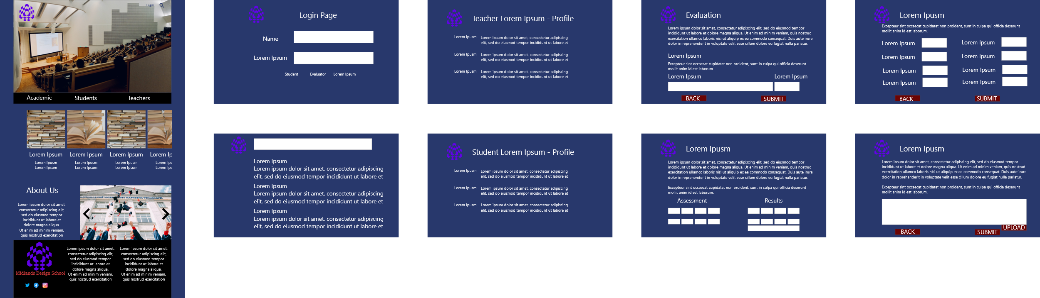
High-fidelity prototype
The final High-fidelity prototype presented makes the user flow more cleaner and more intuitive.
View the StorePicker App
High-fidelity prototype

Slide 25
Going forward
Takeaways
Next steps

Slide 26
Takeaways
Impact:
The users were happy at an integrated but simple solution to handle the assignment workflow along with giving a cleaner interface to the school website. One quote from peer feedback: ‍“This is better than what I expected. Not only can I correct the assignments and grade them, but I can do that on my phone as well!!”
What I learned:
While designing the Grading Website, I learned that the first ideas for the app are only the beginning of the process. Usability studies and peer feedback influenced each iteration of the app’s designs.

Slide 27
Next steps
1
2
3
Conduct another round of usability studies to validate whether the pain points users experienced have been effectively addressed.
Conduct more user research to understand if there are other modules in the app which need to be modified to make the user flow less cluttered.
Conduct more user research to determine any new areas of need.

Slide 28
Insert a few sentences summarizing the next steps you would take with this project and why. Feel free to organize next steps in a bullet point list.
Let’s connect!
Thank you for your time reviewing my work on the Grading Website! If you’d like to see more or get in touch, my contact information is provided below.
Email: cbk124@gmail.com
Website: https://cbkwgl.webflow.io/work/school-grading-website

